Slide 1
DNS
Domain Name System

Slide 2
DNS
husseinnasser
Domain Name System

Slide 3
Why DNS
www.husseinnasser.com
husseinnasser
People can’t remember IPs
A domain is a text points to an IP or a collection of IPs
Additional layer of abstraction is good
IP can change while the domain remain
We can serve the closest IP to a client requesting the same domain
Load balancing

Slide 4

DNS
husseinnasser
A new addressing system means we need a mapping. Meet DNS
If you have an IP and you need the MAC, we use ARP
If you have the name and you need the IP, we use DNS
Built on top of UDP
Port 53
Many records (MX, TXT, A, CNAME)
Google.com
(142.251.40.46)

Slide 5

How DNS works
husseinnasser
DNS resolver - frontend and cache
ROOT Server - Hosts IPs of TLDs
Top level domain server - Hosts IPs of the ANS
Authoritative Name server - Hosts the IP of the target server
ANS
TLD
server
Resolver
ROOT

Slide 6
How DNS works
husseinnasser
What is the IP of google.com (6)
Its 142.251.40.46 (7)
ANS1
What is the IP of google.com (1)
Where is the Authoritative name server of google.com (4)
Its 142.251.40.46 (8)
Here it is ANS1 (5)
TCP handshake (9)
Resolver
TLD1
Where is the .COM servers (2)
Here is a TLD server TLD1 (3)
Google.com
(142.251.40.46)
ROOT

Slide 7
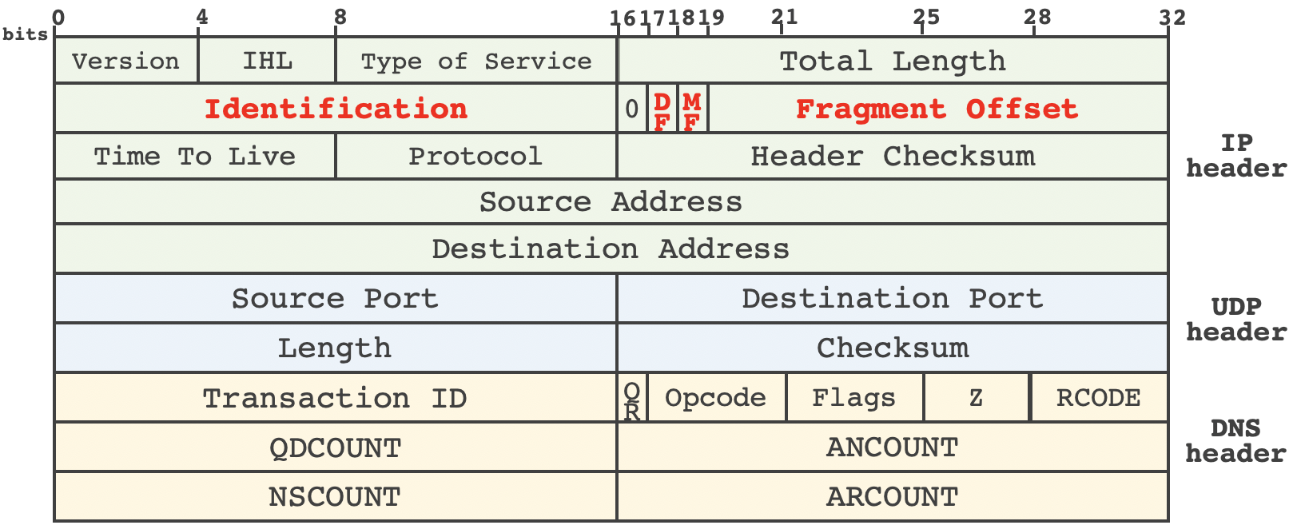
DNS Packet
Source: https://www.usenix.org/system/files/sec20-zheng.pdf
RFC: https://datatracker.ietf.org/doc/html/rfc1035

Slide 8
Notes about DNS
husseinnasser
Why so many layers?
DNS is not encrypted by default.
Many attacks against DNS (DNS hijacking/DNS poisoning)
DoT / DoH attempts to address this

Slide 9
Example
husseinnasser
Let us use nslookup to look up some DNS

